Slide 1
Domestic Violence 101
An Introduction

Slide 2

Who is Agency Name?
Agency mission statement, history, etc. inserted here
Insert agency logo here
Learn more at agencywebsite.org

Slide 3
Learning Objectives
During this training, you will learn the following:
  Recognize the prevalence of domestic violence in the United States and in Georgia
  Identify the definition and dynamics of domestic violence
  Explain the barriers that prevent survivors from leaving an abusive relationship
  Describe the basics of how to support survivors of domestic violence.

Slide 4
What is Domestic Violence/Intimate Partner Violence?
A pattern of behaviors used to gain or maintain power and control over an intimate partner.
Physical Abuse
Sexual Abuse
Financial Control
Emotional Abuse
Stalking and Intimidating Behavior
Isolation
Jealousy

Slide 5
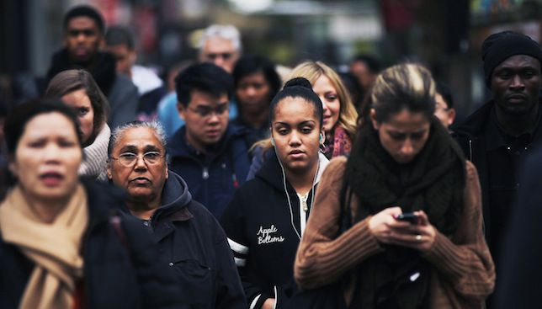
Dynamics of Domestic Violence: Who is the Victim?
All economic groups, races, religions, sexual orientations, professions.
There is no “typical woman” who will be abused.
Domestic violence happens between same-sex couples at similar rates to that of straight couples.
While not the majority, heterosexual men can also be victims of domestic violence.
Notes:
If our personal assumptions do not begin with a complete picture of the economic, social, political, and cultural experiences we are not serving women to our fullest potential. It is essential to explore the accessibility of our services. We must look at all the oppressions women from marginalized communities may be facing when they seek domestic violence services. We must understand and assess the converging identities and to recognize that one-size-fits-all approach may not work.

Slide 6
Dynamics of Domestic Violence: Who is the Abuser?
Can be anyone
Not obviously aggressive or violent (most but not all)
Charm, charisma, intelligence—all tools for gaining trust and control
Often perceived as a “great person, helpful and trustworthy” by the community
Not about anger management, but about feeling entitled to have power in the relationship
Notes:
Unscripted: Despite what many people think, it’s not easy to tell who is an abuser and who isn’t.
Most abusers do a really good job of hiding their violent behavior from friends, extended family, neighbors, etc.
Many victims describe their partner as having a keen ability to get people to like them, do what they want, etc.
In most relationships, the abuse and violence slowly builds. Tactics of emotional abuse usually happen first and can be very difficult to identify when it’s happening. Physical abuse may not begin until months or years into the relationship and may begin with relatively minor types of physical violence that don’t cause injury, then slowly become more dangerous over time.
Leaving an abusive relationship (or simply planning to leave) is actually the most dangerous time. Most victims are killed after or during the process of leaving. Giving a victim the advice to “just leave” is irresponsible and dangerous. Safety planning with a training dv advocate can help a survivor to leave safely

Slide 7

Domestic Violence Affects Us Globally
Around the world, at least 1 in 3 women has been abused during her lifetime.
Intimate partners commit 40-70 percent of homicides of women worldwide.

Slide 8
Domestic Violence Affects Us Nationally
  About 1 in 4 women and nearly 1 in 9 men were victims of sexual violence, physical violence, and/or stalking by an intimate partner in their lifetime.
  47.1%, or nearly half, of U.S. women reported experiencing emotional abuse by an intimate partner during their lifetime.
  1 in 6 women and 1 in 19 men experienced stalking at some point during their lifetime.

Slide 9

Domestic Violence Affects Us Locally
From 2003 through 2016, at least 1,671​ Georgians lost their lives due to domestic violence. Click HERE to learn more about the Georgia Annual Fatality Review Report.
Domestic violence is a leading cause of injuries for girls and women between the ages of 15 and 44 in Georgia.
736 Georgians were killed by firearm in domestic violence incidents between 2010 and 2017.
Notes:
In 2015, 139 victims and perpetrators in Georgia lost their lives due to domestic violence.
Domestic violence is a leading cause of injuries for girls and women between the ages of 15 and 44 in Georgia.
In 2013 Georgia ranked 17th in the nation for its rate of women killed by men.

Slide 10
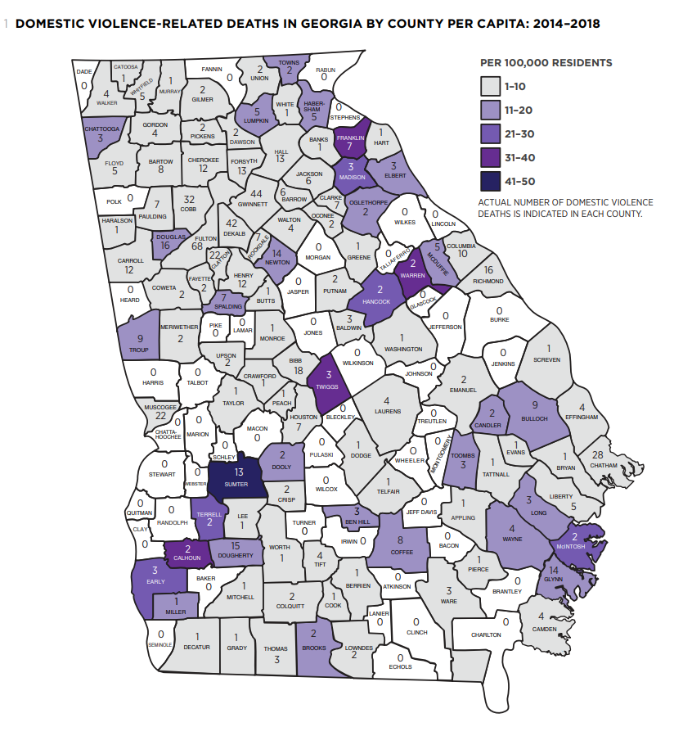
DV Fatalities in Georgia
Chart 1 shows both the per capita homicide rate and actual numbers of deaths by county known to have occurred from2014–2018.
Georgiafatalityreview.com

Slide 11
What does domestic violence look like?
Abusive tactics and behaviors, myths and facts

Slide 12
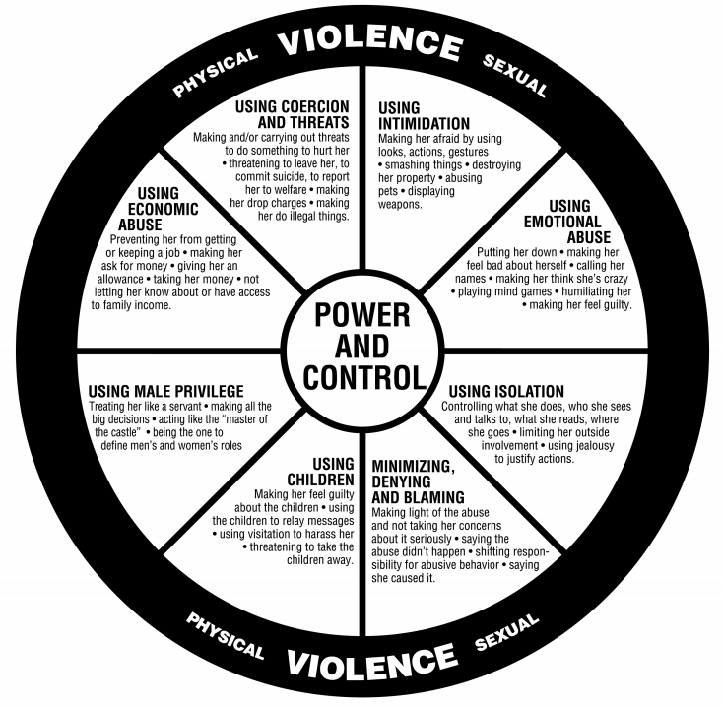
The Power & Control Wheel

Slide 13
Not Just Physical Violence
Emotional Abuse
  Name calling
  Constant insults, put-downs
  Manipulation
Coercive Control
  Threats of violence
  Controlling/limiting access to finances
  Stalking/intimidation
Isolation
  Separating from family and friends
  Not allowing to work
  Constantly checking phone, email
Using the kids
  Threating to take the kids
  Threats or acts of abuse
  Forcing to take sides

Slide 14

Myth vs. Reality
Myth: Alcohol and drug use and abuse causes domestic violence. Certain people become abusers when they drink or use drugs.
Reality: Alcohol or drug use is not a cause of domestic violence. An abuser who is intoxicated may use greater force, but abusive behavior is a choice.

Slide 15

Myth vs. Reality
Myth: Abusive behavior is caused by a mental illness, such as bipolar disorder or a personality disorder. All abusers are narcissists.
Reality: Most people living with a mental illness do not batter their partners. Mental illness is not a cause of domestic violence.

Slide 16

Myth vs. Reality
Myth: Victims stay in abusive relationships because they are co-dependent, or because they’re “addicted” to the abusive relationship.
Reality: Leaving an abusive relationship is incredibly difficult, and it is the most dangerous time for the victim. Many victims want to leave, but a number of barriers prevent them from doing so.
Safety planning with a trained advocate can help a victim to leave safely.

Slide 17
“Why I Stayed...”
https://youtu.be/IU50HksugZk (consider embedding this video in your slide)

Slide 18

Barriers created by the batterer:
Threats to harm survivor, survivor’s family, children
Stalking, monitoring
Sabotage job, housing, transportation
Isolation from family and friends
Financial control
Escalation of physical violence
FEAR

Slide 19
External Barriers:
Environmental
Criminal Justice
Access to safe housing
Employment
Transportation
Resources
  Shelter
  Legal assistance
  Counseling
How law enforcement or court systems respond to DV calls or cases
Criminal justice system not seen as a helpful resource
  Undocumented immigrants
  Communities of color
  Low socioeconomic neighborhoods

Slide 20
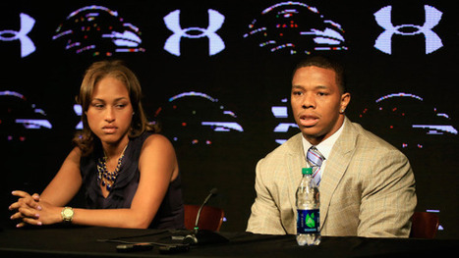



Social Barriers:
Social media and pop culture – violence is normal
Religious beliefs
Family pressure
Gender roles
Control and jealousy = love
Cultural practices

Slide 21
How can I help?
What to do if someone you know is in a violent relationship

Slide 22

Safety Planning & Support
Identify resources (crisis line, safe house, supportive friends or family)
Plan an escape route
Secret code word, steps for children
Keep a secret stash of cash
Spare car keys, cell phone
Consider social media tracking, other digital tracking
DON’T let the abusive partner know that you’re preparing to leave
Reach out to a trained domestic violence advocate for help: 1-800-33-HAVEN (1-800-334-2836)
Notes:
.

Slide 23
How to help someone being abused
Do’s and Don’ts
Do
Don't
Listen without judging or telling them what to do. Believe what they tell you.
Say “I am concerned for your safety” or “I care about you.”
Support their decisions—even if you disagree with them.
Remain calm. If you react strongly or insist on calling 911, they may shut down.
Push them to leave the relationship before they’re ready. Leaving can be the most dangerous time for the survivor.
Don’t blame them for the abuse that has happened by saying “why don’t you just leave” or “ I would never let someone treat me that way.”
Don’t tell others what they have told you unless you have permission.

Slide 24
How to help someone being abused
Do’s and Don’ts
Do
Don't
Let them know that the abuse is not their fault.
Offer to help connect them with resources; offer to do the legwork for them by calling and asking questions about services on their behalf.
Talk to them about creating a safety plan.
Push printed materials on them that the abuser might find.
Suggest that the abuse will stop if the abuser gets counseling or treatment, or if the survivor changes their own behavior.
Give advice. Ask them what they think would be the next best step.

Slide 25
More about “Agency Name”
Services and programs, events, and volunteer opportunities

Slide 26
How “Agency Name” helps survivors
List of services and programs
Example:
Community Support Groups
  Contact advocate@agency.com for more information

Slide 27
How you can help “Agency Name”
Volunteer opportunities
  Childcare
  Transportation
  Supporting events
  Collecting shelter supplies
    Neighborhood drives
    Birthday parties – instead of a gift, bring a shelter item to donate
    Facebook fundraisers

Slide 28
How to Contact Us
Agency Name
Crisis Line: 123-456-7890
Website: www.agencyname.org
Thank You!

